Slide 1
Applied Data Science and visualization 2024
Lecture 5 John Shorter

Slide 2

What are we learn last time?
ANOVAs are very simple in R
Data transformation is also easy
We learned that non-parametric testing is also straightforward

Slide 3
What are we going to do today?
We are first going to discuss the mini-project
We are going to work much more with ANOVAs today, introducing more complicated designs, including interaction terms
If we have time, we will then discuss how to analyze data that is numeric by numeric (Correlation and regression)

Slide 4
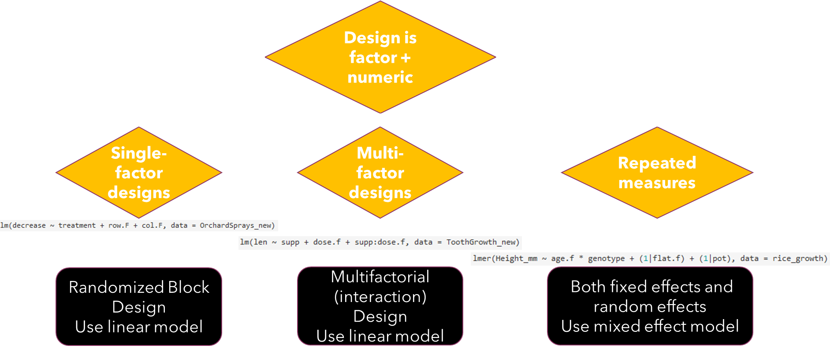

Slide 5
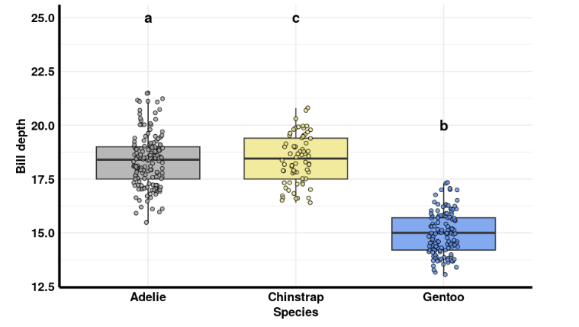
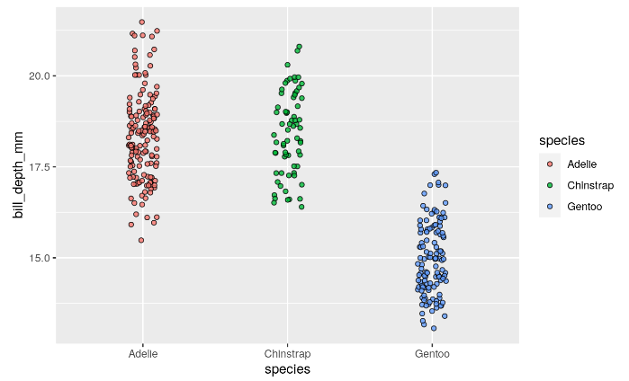
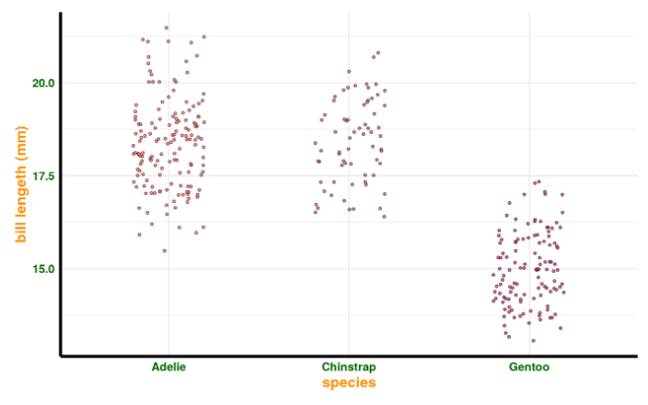
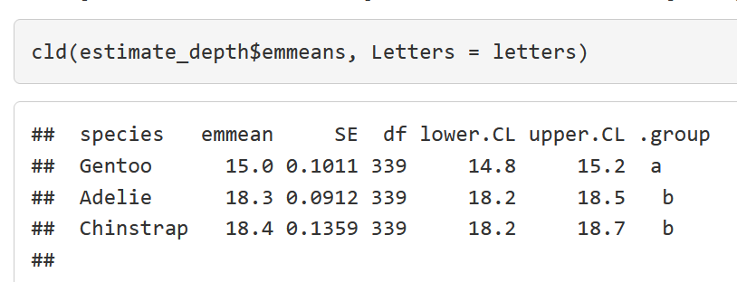
Nice examples with Anovas

Slide 6
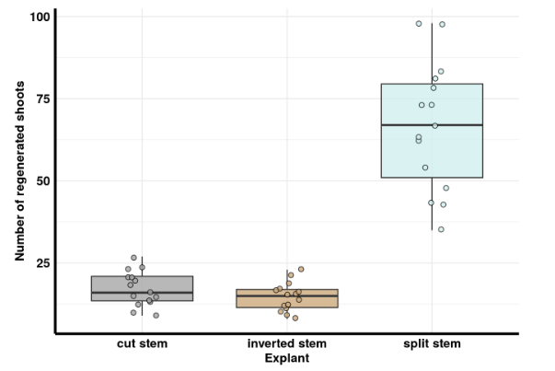
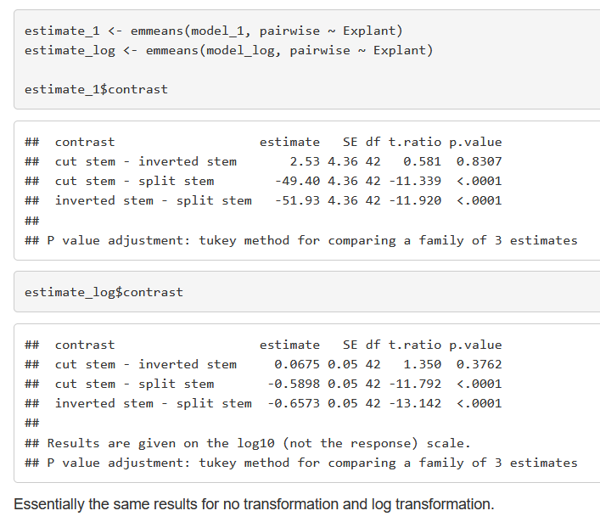
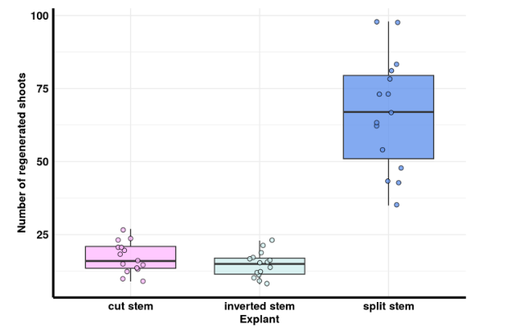
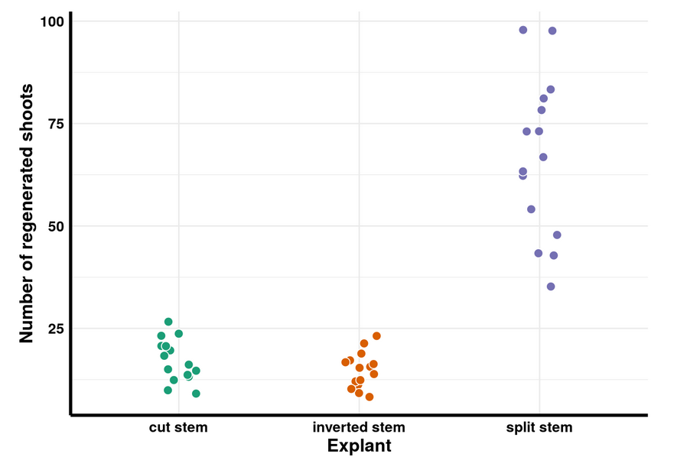
Nice examples from the homework

Slide 7
Let’s get started and go to moodle and open the mini-project assignment
https://www.kaggle.com/datasets #Find data here
https://www.gapminder.org/data/ #Find data here
https://r-graph-gallery.com/ #Find plot ideas here
https://rucdk-my.sharepoint.com/:x:/g/personal/johnsh_ruc_dk/ER90DKTVQfRErBM5qLkqsiIBuMJFrZGnQzKZQeD9LkXrjg?e=1SFPu0&wdLOR=c869E54A9-F9E0-4DE3-A6BC-E289AB3AEAA0
Fill in this sheet with your name and selected dataset before next lecture, March 20.

